Slide 1

Responsive Web Design
Thinking inside the box
Steven Miller
Twitter: @RadjQueryNinja
Blog: VanillaFolder.net
Github: VanillaNinja

Slide 2

“Borrowed” Knowledge

Slide 3
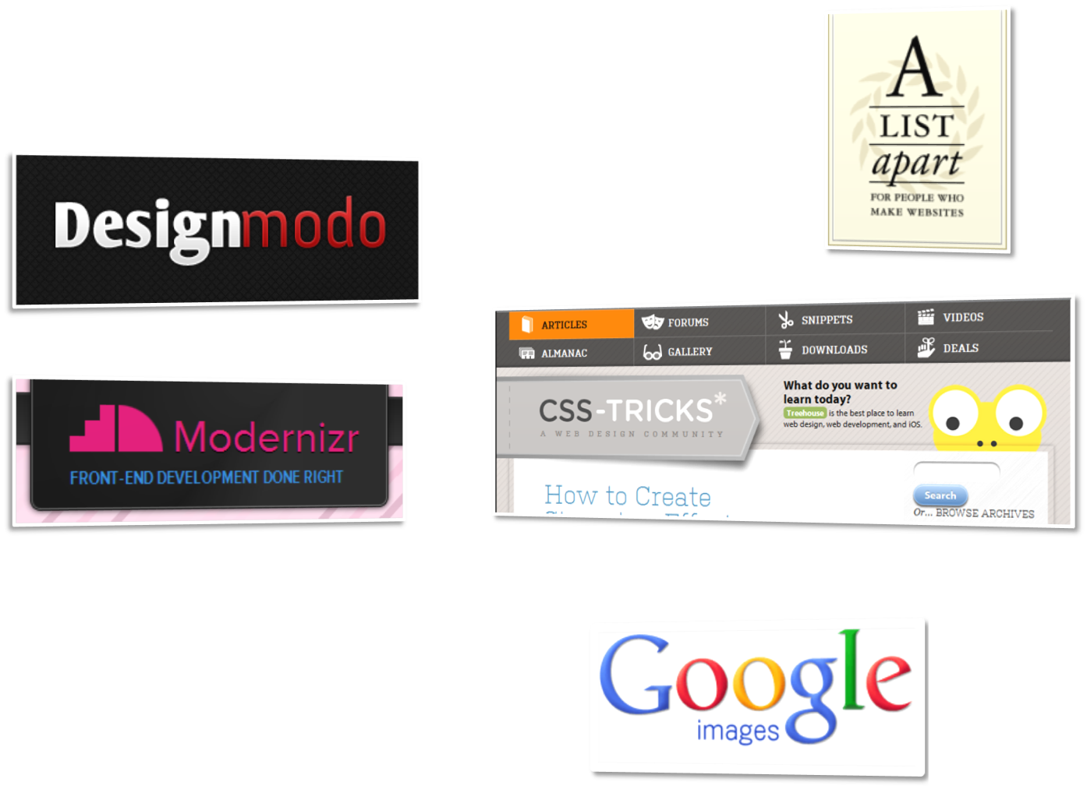
Other “Borrowed” Stuff
Special thanks to all
who contributed to …

Slide 4


What’s the most
frustrating part of
web development?
Notes:
Browser constraints

Slide 5
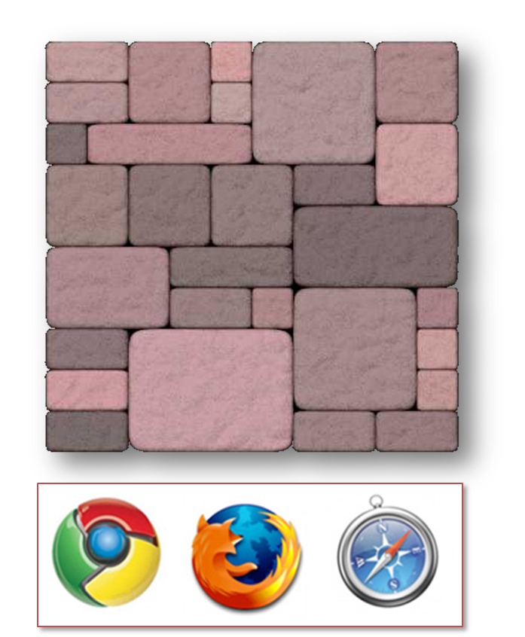

Notes:
Print designers took over Show CSS for 960 grid

Slide 6
CSS Browser Hacks
<link href="all.css" rel="stylesheet" type="text/css"/>
<!--[if IE]>
<link href="ie.css" rel="stylesheet" type="text/css"/>
<![endif]-->
<!--[if lt IE 7]>
<link href="ie.below.7.css" rel="stylesheet" type="text/css"/>
<![endif]-->
<!--[if !lt IE 7]>
<link href=“newer.css" rel="stylesheet" type="text/css"/>
<!--<![endif]-->
<!--[if !IE]>-->
<link href="not.ie.css" rel="stylesheet" type="text/css"/>
<!--<![endif]-->
.widget{ display: block; width: 200; float: left; }
* html .widget { zoom: 1;}

Slide 7
Why Bother?
People like pretty
“Several studies have conclusively shown that attractive user interfaces are easier to use than [ugly] interfaces”
- Pragmatic Thinking & Learning, Andy Hunt

Slide 8


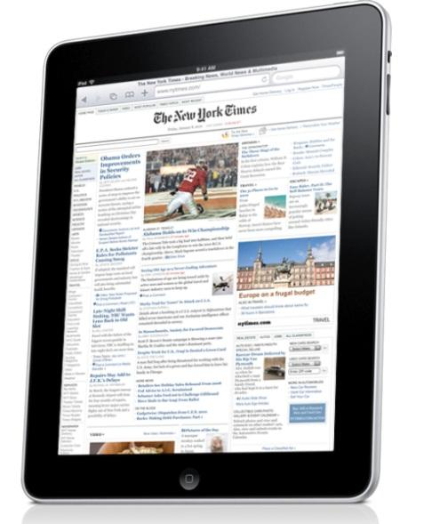

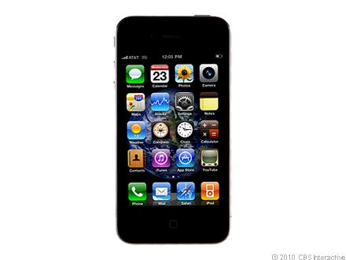
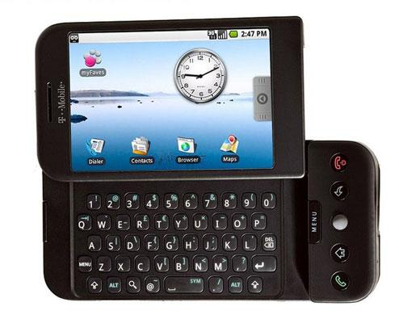



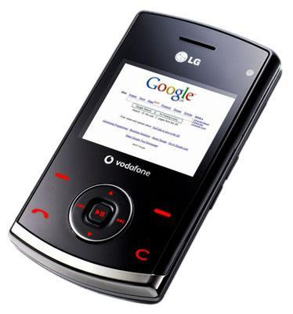


Notes:
CRT monitors, lcd, tablets smart phones, readers, feature phones, Giant screens, and each with the potential of multiple browsers on each

Slide 9
A Dao of Web Design
by John Allsopp
APRIL 7, 2000
http://www.alistapart.com/articles/dao/

Slide 10
A Dao of Web Design
“A newborn is soft and tender, A crone, hard and stiff. Plants and animals, in life,
are supple and succulent; In death, withered and dry. So softness and tenderness are attributes of life, And hardness and stiffness, attributes of death.”
Tao Te Ching; 76 Flexibility

Slide 11
A Dao of Web Design
FONTS
“… the same font, at the same point size on a Macintosh ‘looks smaller’ than on most Windows machines … if you embrace the adaptability philosophy it doesn’t matter.”

Slide 12
A Dao of Web Design
LAYOUTS
“As with fixed font sizes, fixed page layout can lead to accessibility problems on the web.”

Slide 13
Moving Forward
IYAD-WYAD-YAG-WYAG*
*If you always do – what you always did
you’ll always get – what you always got

Slide 14
Innovation
IYAD-WYAD-YS*
*If you always do – what you always did
you’re screwed

Slide 15
Responsive Web Design
1. Flexible, grid-based layout
2. Flexible images and media
3. CSS3 Media queries
4. Feature Detection / Polyfills

Slide 16
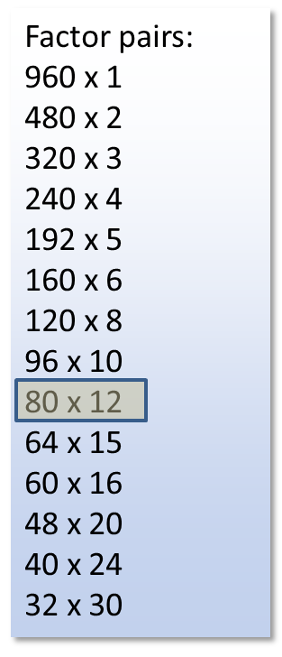

Notes:
Print designers took over Show CSS for 960 grid

Slide 17
Flexibility = Relativity

Slide 18


Slide 19
Context for Font size
100% = 12pt = 16px

Slide 20
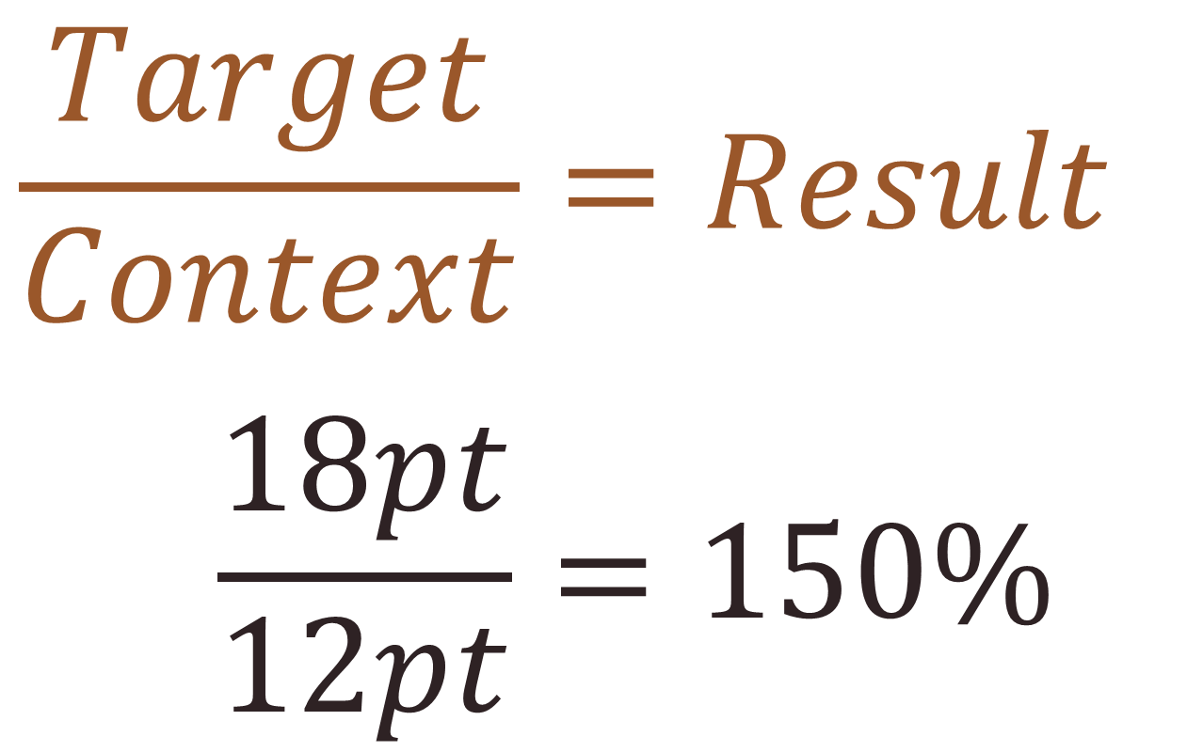

Slide 21
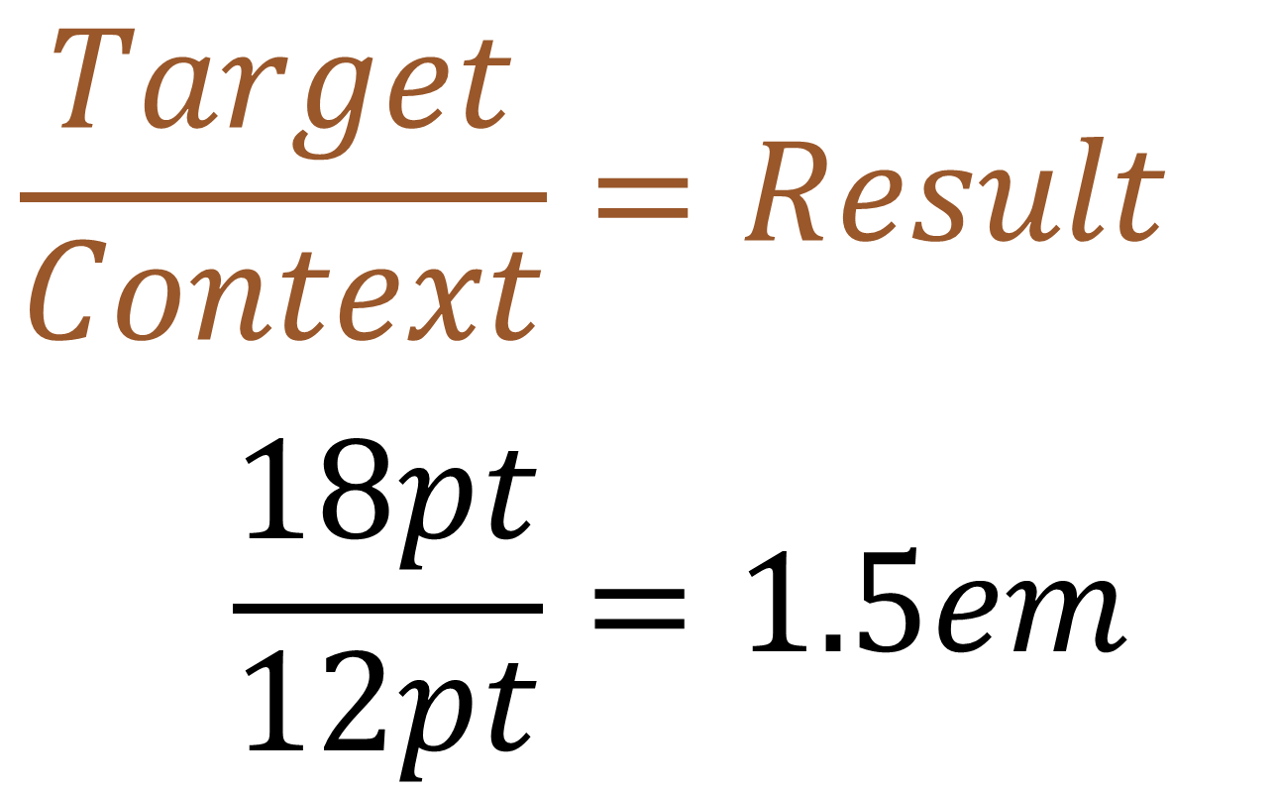

Slide 22
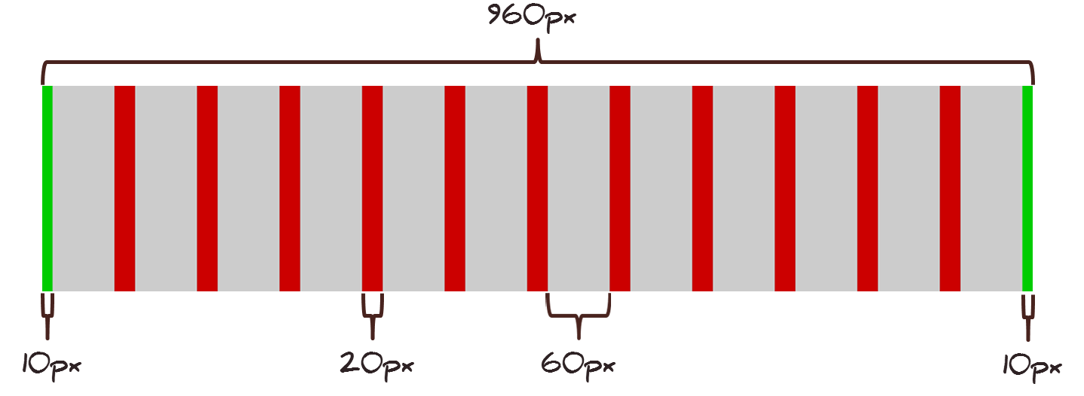
Pizzamore 960px grid
12 Column grid
10px L/R margins
20px gutters
60px columns

Slide 23

Pizzamore Content Inventory
Head Navigation – 5 column
Title Banner – 12 column
Main Title Image – 11 column
Pizza Image – 5 column
Title Text– 7 column
Site Blurb – 10 column
Content Area – 12 column
Article – 9 column
Posts – 5 column
Pizza Roll – 12 column
Pizza Roll Content – 10 column
Links – 10 column
Menu Links – 5 column
Spice Links – 5 column
Footer – 10 column

Slide 24
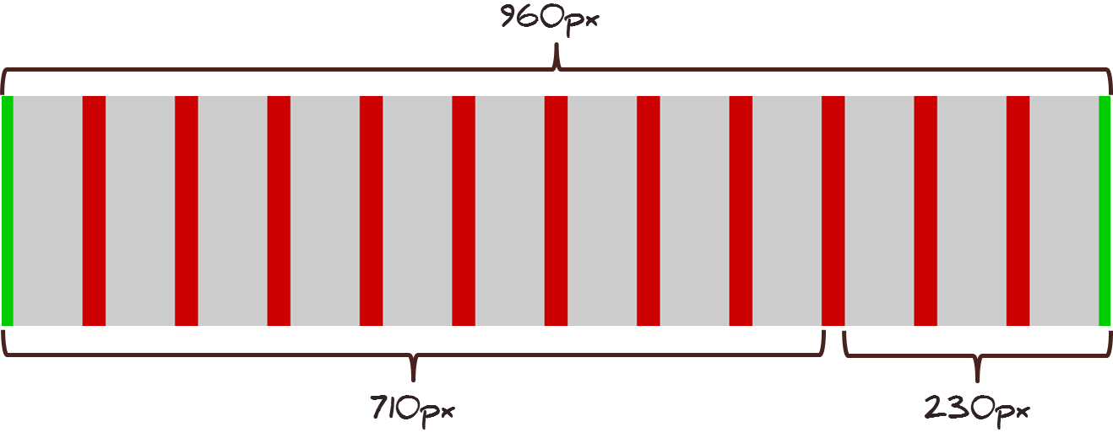
Pizzamore Content Area Layout
Article 9 Columns
710px wide
Posts 3 Columns
230px wide

Slide 25
Flexible Images
img {
max-width: 100%;
height: auto;
}

Slide 26
Flexible Media
img,
embed,
object,
video{
max-width: 100%;
height: auto;
}

Slide 27
Media Queries
Inside style sheet
@media screen and (min-width: 1024px) {
body {
font-size: 120%;
}
}

Slide 28
Media Queries
Media attribute on link element
<link rel="stylesheet“ href=“style/big.css" media="screen and (min-width: 1024px)"/>

Slide 29
Media Queries
Or use import statement
@import url(“big.css")
screen and (min-width: 1024px);

Slide 30
Viewport
Control for canvas size
<meta
name="viewport"
content="initial-scale=1.0, width=device-width"
/>

Slide 31
pol·y·fill /’pälēfil/ n.
“A shim that mimics a future API, providing fallback functionality to older browsers.” – Paul Irish

Slide 32
fea·ture de·tec·tion
/’fēCHər diˈtekSHən/ n.
“[A method] to reliably discern what the various browsers can and cannot do.” – modernizr.com

Slide 33
Graceful Degradation
vs.
Progressive Enhancement

Slide 34
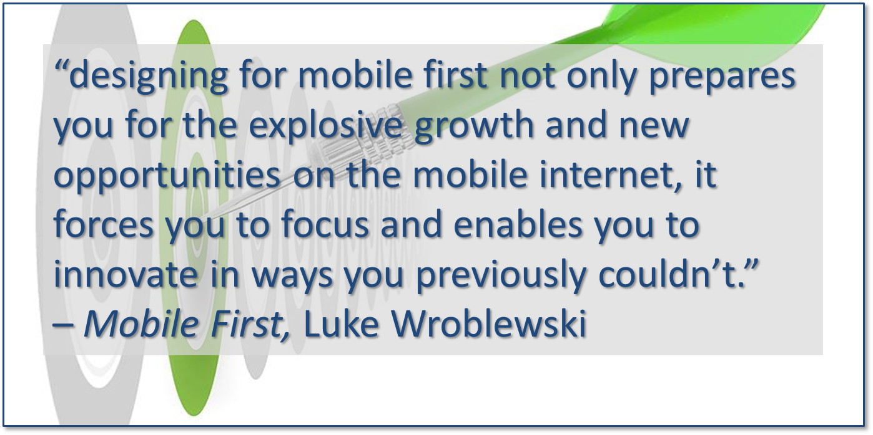
Mobile First

Slide 35
Responsive Design Tools
Browser Resizing
Resizer (Bookmarklet): codebomber.com/jquery/resizer
Multiple sizes at once (hosted): mattkersley.com/responsive
Responsivepx (test local): responsivepx.com
Text Scaling
FitTextjs - fittextjs.com
Calculators
A Fluid Grid Calculator: csswizardry.com/fluid-grids
px to em calculator - pxtoem.com

Slide 36
Polyfill Tools
Start Here
Modernizr: modernizr.com
Media Queries
Respond.js: github.com/scottjehl/Respond
CSS3 Media Queries.js: code.google.com/p/css3-mediaqueries-js
Display Browser Features
Haz.io: haz.io

Slide 37
Great Reads
Books:
Responsive Web Design: abookapart.com/products/responsive-web-design
Adaptive Web Design: easy-readers.net/books/adaptive-web-design
Mobile First: abookapart.com/products/mobile-first
Blogs:
CSS Tricks: css-tricks.com
A List Apart: alistapart.com
Design Modo: designmodo.com
Articles:
The DAO of Web Design: www.alistapart.com/articles/dao
Redefining web: trentwalton.com/2012/02/02/redefined

Slide 38
Questions?
Steven Miller
Twitter: @RadjQueryNinja
Blog: VanillaFolder.net
Github: VanillaNinja

